Slide 1
Himalayan Climbing Expeditions

Slide 2
Reason for Selection

Slide 3
Data Source

Slide 4
Questions to be Answered

Slide 5
Data Exploration
Comparing variables with success rate
Variable to be explored:
Age
Group size
Month
Peak Height
Gender

Slide 6
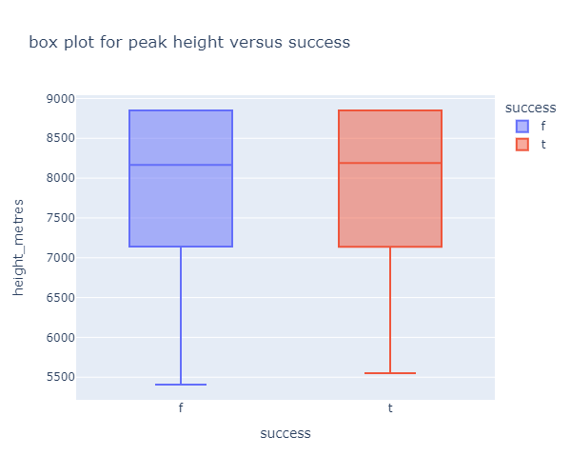
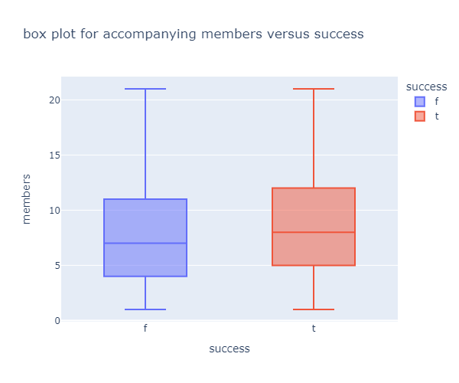
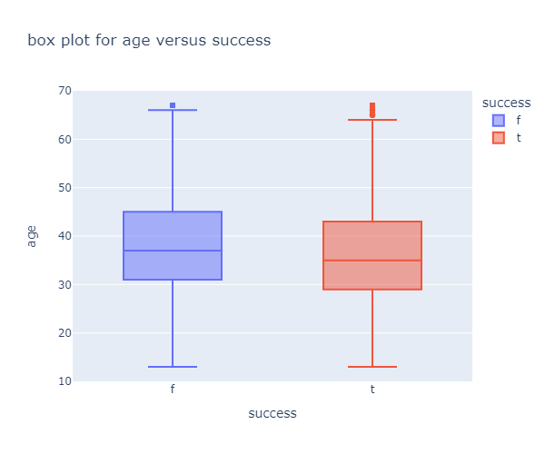
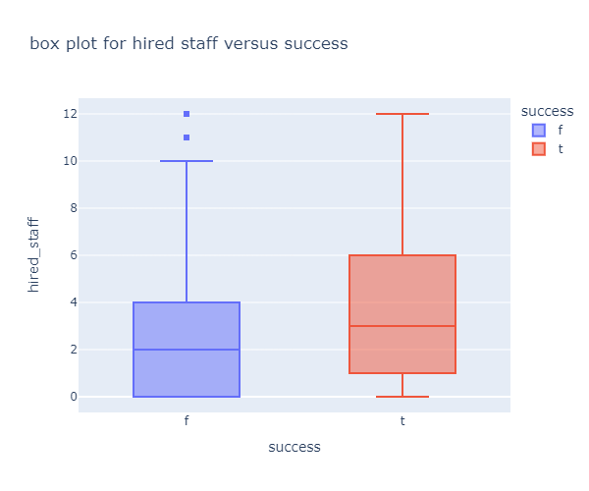
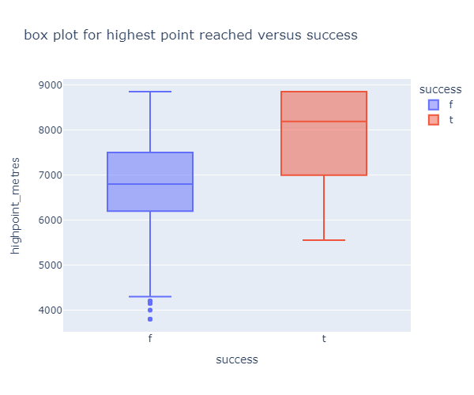
Exploratory Data Analysis
f (blue) = Failure
t (red) = Success

Slide 7
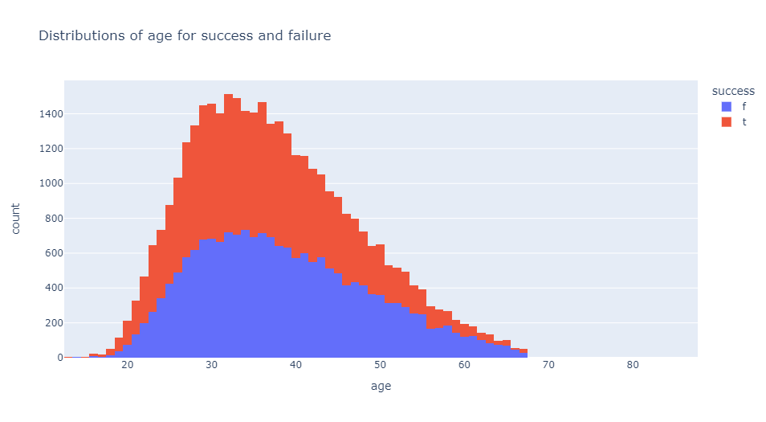
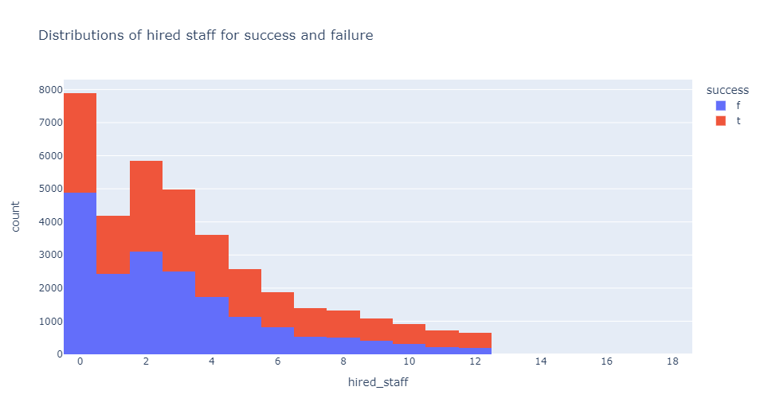
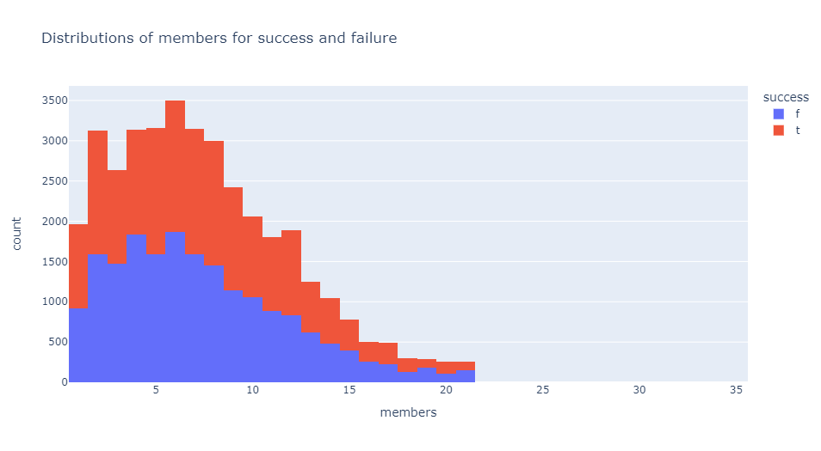
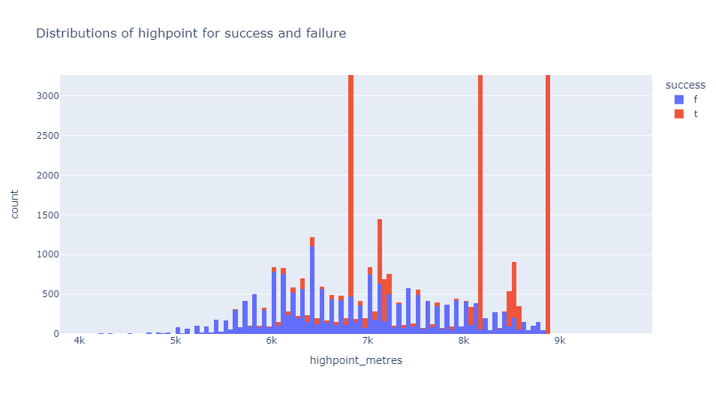
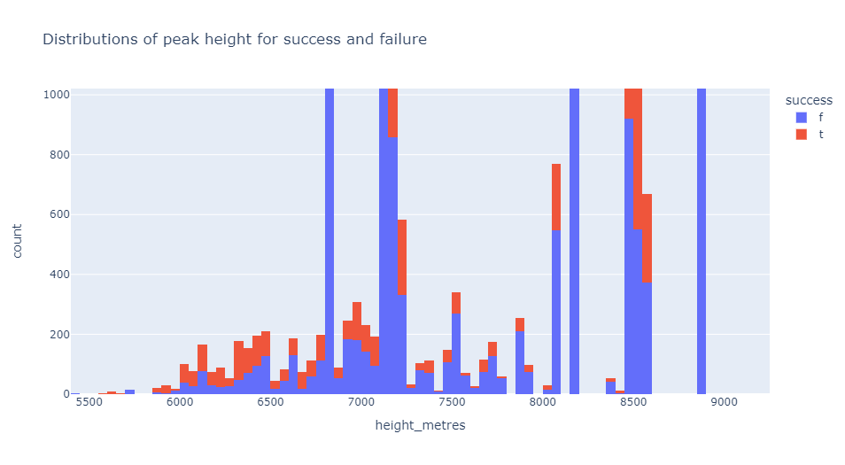
Exploratory Data Analysis
f (blue) = Failure
t (red) = Success

Slide 8
Dashboard Blueprint

